Slide 1

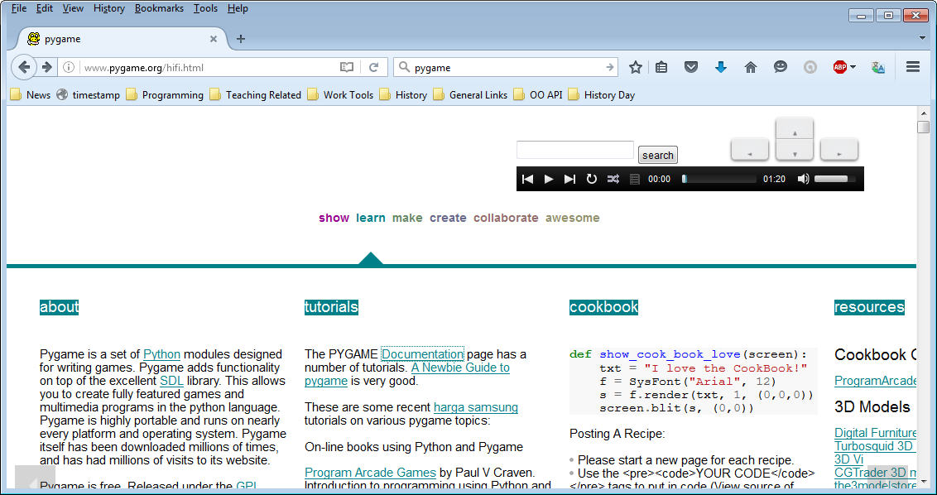
2. Installing Pygame
Let’s Learn
Aj. Andrew Davison, CoE, PSU Hat Yai Campus
E-mail: ad@fivedots.coe.psu.ac.th
http://www.pygame.org/

Slide 2
Outline
What is Pygame?
Installing Pygame
Run "pygameTemplate.py"
pygameTemplate.py Explained

Slide 3
1. What is Pygame?
A set of modules for writing games
home page: http://pygame.org/
documentation: http://pygame.org/docs/
pyGame helps you with:
2D graphics (and 3D)
images, sounds, music, (video)
user input (events) from keyboard, mouse, gamepad
support for game things
sprites, collision detection, etc.

Slide 4
pyGame Modules
The modules include:
cdrom cursors display draw event
font image joystick key mixer
mouse movie music overlay rect
sndarray sprite surface surfarray
time transform
Search page:
http://www.pygame.org/docs/search.html

Slide 5
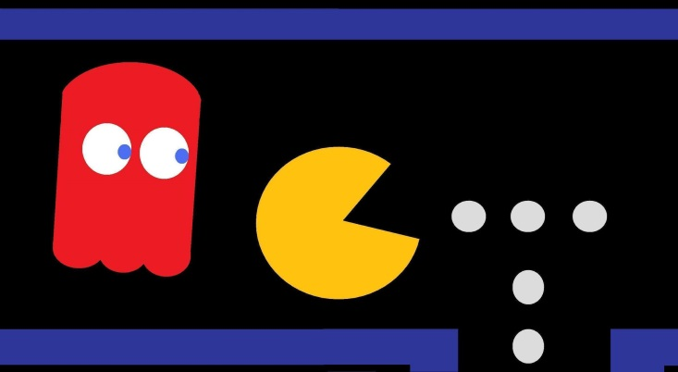
Game Things in Pygame
sprites: moving game characters / objects
collision detection: which sprites are touching?
event: a user action (e.g. mouse or key press), or computer change (e.g. clock tick)
game loop:
read new events
update sprites and game state
redraw game

Slide 6
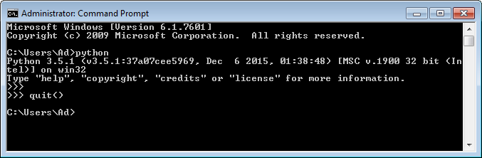
2. Installing Pygame
Install python first!
make sure you can call python 3 and pip from a command window
I'm using 32-bit Python 3.5.1

Slide 7
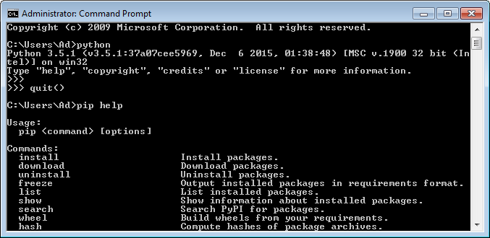

Slide 8
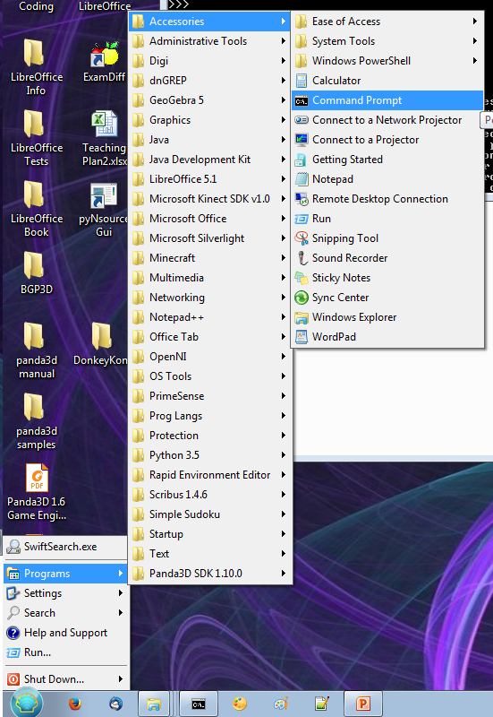
What's a Command Window?
Also called a command prompt or shell.
Look in the "Accessories" menu or perhaps on the taskbar

Slide 9
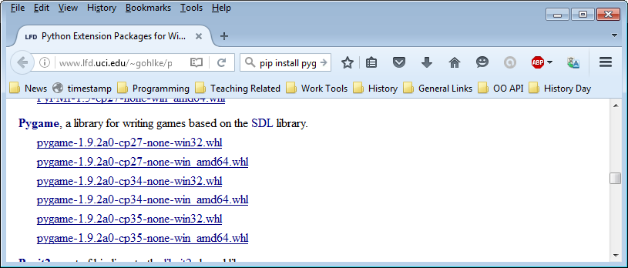
Install Pygame for Python 3.5
Download 32-bit or 64-bit WHL installer from
http://www.lfd.uci.edu/~gohlke/pythonlibs/#pygame
Get "cp35" version,
either 32 or 64

Slide 10
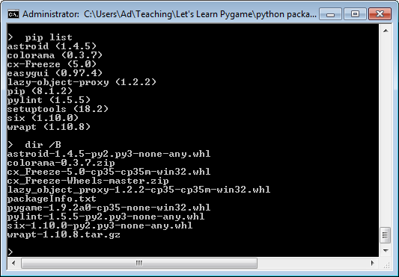
Is pygame installed? no
Is pygame WHL file here? yes

Slide 11
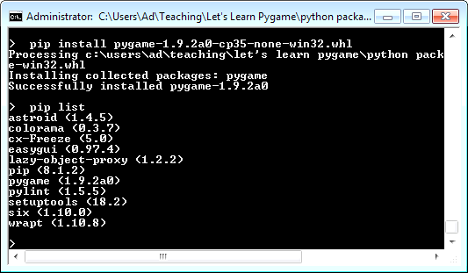
Install WHL file using pip
Check pip list

Slide 12
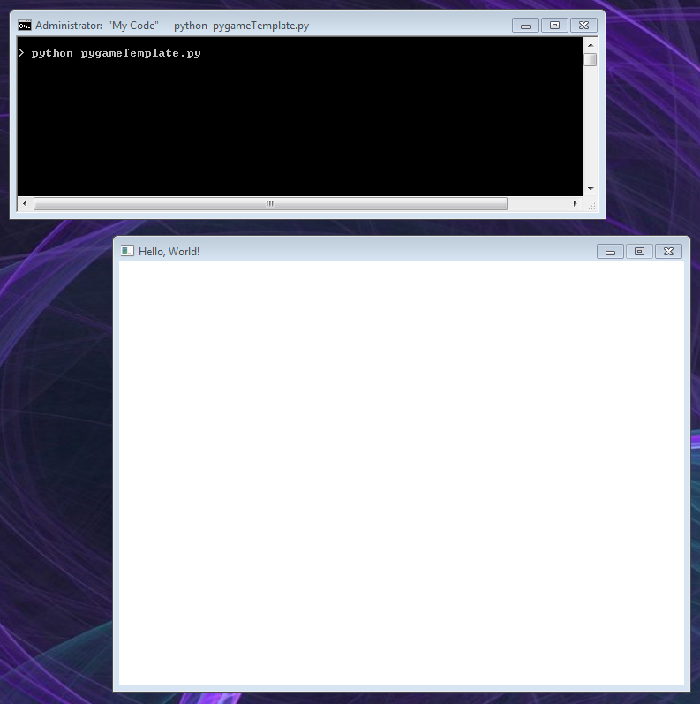
3. Run "pygameTemplate.py"
python pygameTemplate.py
A pygame
game window

Slide 13
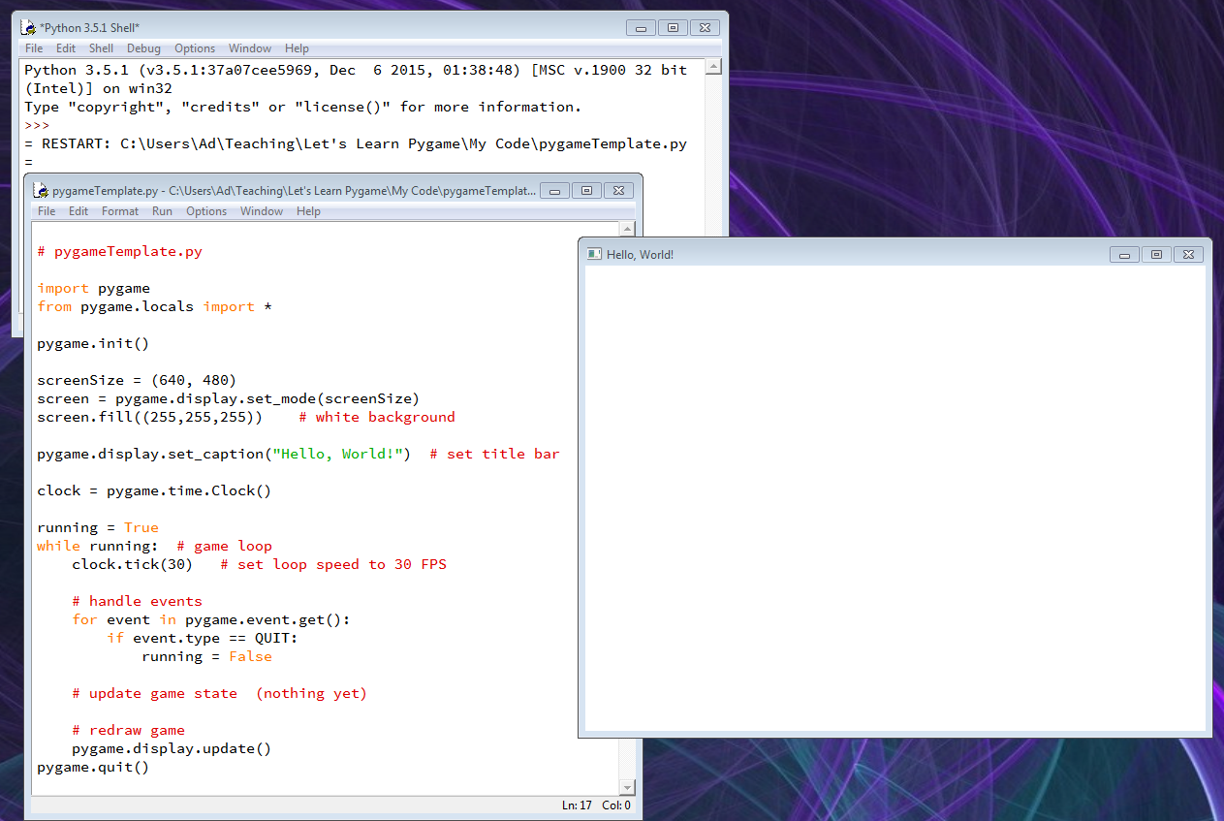
Using IDLE
A pygame
game window

Slide 14
4. pygameTemplate.py Explained
import pygame
from pygame.locals import *
pygame.init()
screenSize = (640, 480)
screen = pygame.display.set_mode(screenSize)
screen.fill((255,255,255)) # white background
pygame.display.set_caption("Hello, World!") # set title bar
clock = pygame.time.Clock()
:
:

Slide 15
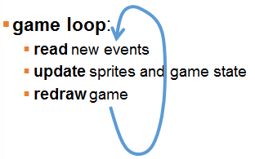
running = True
while running: # game loop
clock.tick(30) # set loop speed to 30 FPS
# handle events
for event in pygame.event.get():
if event.type == QUIT:
running = False
# update game state (nothing yet)
# redraw game
pygame.display.update()
pygame.quit()

Slide 16
4.1. Creating a Pygame Window
screen = pygame.display.set_mode((640,480))
set_mode() can take three arguments:
(width,height), flag(s), bit-depth
flags let the window become full-screen and resizeable
bit-depth sets the number of colors that can be used

Slide 17
4.2. Pygame Colors
screen.fill((255,255,255)) # white background
A color is made from three integers (0-255) for the amount of red, green, and blue (RGB):
0 means "no color"
255 means "maximum color"
e.g. (0,0,0) means "black"

Slide 18
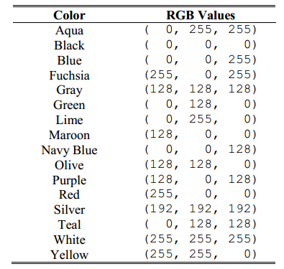
Some Common Colors

Slide 19
Built-in Color Names
The pygame.color module as a large dictionary of predefined color names, called THECOLORS
Import it to use color names instead of (R,G,B) tuples:
from pygame.color import THECOLORS # 600 color names
:
screen.fill(THECOLORS['white'])

Slide 20
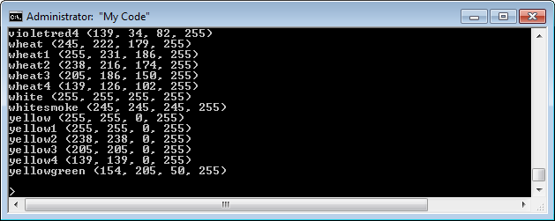
What names, what colors?
Add the for-loop:
for key in sorted(THECOLORS): print(key, THECOLORS[key]) # sorted print
Or have a look at a color table online:
https://www.pygame.org/docs/ref/color_list.html

Slide 21
4.3. Frames per Second (FPS)
clock.tick(30) sets pygame's loop to run at a speed of about 30 frames/sec (FPS)
A frame = one game loop:
handle events, update game state, redraw game
30 FPS = 30 frames(loops) in 1 second
so 1 frame (loop) = 1/30 sec = 1000/30 millisecs (ms) ≈ 33 ms

Slide 22
Why about 30 FPS?
If the work inside the loop is big, then the loop can take longer than 33 ms.
If the work is small, and takes less than 33 ms, then Pygame will wait until 33 ms has passed before repeating the loop.

Slide 23
Why Use FPS?
Games are easier to program if we know that one loop takes a fixed amount of time
in our case, 1 loop = 33 ms
e.g. a game object that should be on-screen for 5 seconds will need to be drawn in 150 (30*5) loops
1 sec == 30 FPS
5 secs == 30*5 == 150

Slide 24
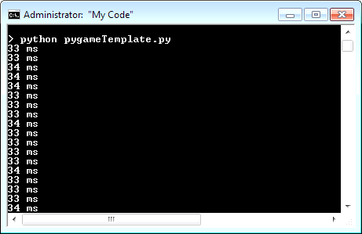
Checking the FPS
Modify pygameTemplate.py to print the actual time used for 1 loop.
Inside the game loop:
time_passed = clock.tick(30) # set loop speed to 30 FPS print(time_passed, "ms")

Slide 25
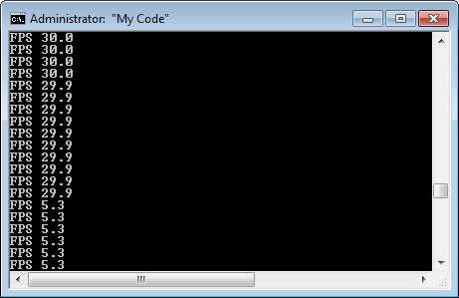
Or you can print the average FPS using clock.get_fps():
print("FPS", round(clock.get_fps(),1))
Game loop
slowed down
for a while
(lots of work)

Slide 26
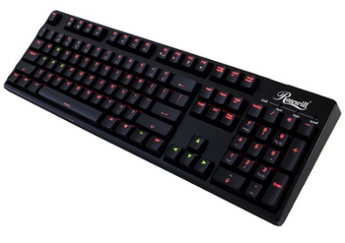

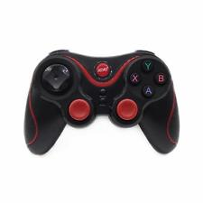
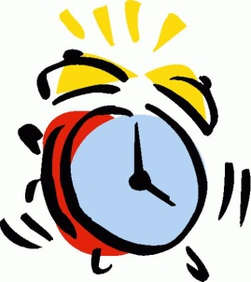

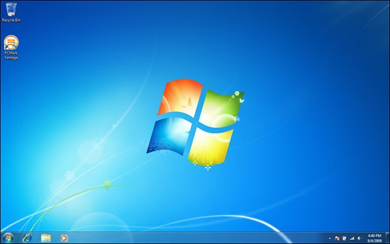
4.4. Events
An event is a user action (e.g. mouse or key press), or a computer change (e.g. clock tick).
a bit like "messages" sent to Pygame from the user and computer
handle events
update game state
redraw game

Slide 27
The "quit" event
for event in pygame.event.get():
if event.type == QUIT: # user clicks close box
running = False
When running is false, the game loop ends, and Pygame quits.

Slide 28
Quit by Also Typing <Esc>
for event in pygame.event.get():
if event.type == QUIT: # user clicks close box
running = False
if (event.type == KEYUP and event.key == K_ESCAPE):
running = False
Or combine into a single expression:
for event in pygame.event.get():
if (event.type == QUIT) or \ (event.type == KEYUP and event.key == K_ESCAPE):
running = False

Slide 29
Keyboard Events
KEYDOWN is sent when a key is pressed
KEYUP is sent when a key is released
Each key has a constant that begins with K_:
alphabet keys are K_a through K_z
Others: K_SPACE, K_RETURN, K_ESCAPE, etc.
For a complete list see
http://www.pygame.org/docs/ref/key.html

Slide 30
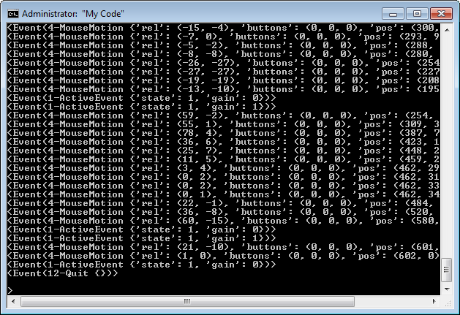
Other Events
Add print(event) to for-loop to see many events arriving at game loop.

